Slide 1
CSC 504- Concurrent systems
Lecture Series 2
OLADEJI F.A
foladeji@unilag.edu.ng
07033629809

Slide 2
multiprocessor systems as follows:
Loosely coupled multiprocessor: Consists of a collection of relatively autonomous systems, each processor having its own main memory and I/O channels. This category is addressed under Networking and Distributed processing.
Functionally specialized processors: Such as I/O processors, Math processors, Network interface cards. In this case, there is a master general-purpose processor; specialized processors are controlled by the master processor and provide services to it.
Tightly coupled multiprocessing processors that share a common main memory and are under the integrated control of an operating system.

Slide 3
Concurrent systems
Modern computers have more than one processors embedded on the same motherboard
Multiple control signals are generated at the same time and the processors execute concurrently
Overlapping of fetch and execute operations occur as many processors operate in parallel.
This approach breeds superscalar organization, which exploits instruction-level parallelism.
In multiprocessor setup, the memory is taken as a unit of its own such that the processor consists of the control unit, registers and arithmetic unit.
These processes communicate and compete for the limited systems resources - processor, memory, I/O devices, secondary storage, system variables etc.
The two main requirements in this communication: the need for Co-operation and the need for Competition.

Slide 4
Classes of multiprocessor systems
Loosely coupled multiprocessor: Consists of a collection of relatively autonomous systems, each processor having its own main memory and I/O channels. This category is addressed under Networking and Distributed processing.
Functionally specialized processors: Such as I/O processors, Math processors, Network interface cards. In this case, there is a master general-purpose processor; specialized processors are controlled by the master processor and provide services to it.
Tightly coupled multiprocessing processors that share a common main memory and are under the integrated control of an operating system.

Slide 5
Test 1
1. list 4 resources that OS manages
2. Differentiate between a page and a frame
3. What is cycle stealing?
Lab !:
Group A: Dinning philosopher: surname A to H
Group B: Reader/Writer : surname O, AND I
Group C: Consumer/Producer: surname J-N, P-Z
Deadline March 27, 2019 (Presentation Lecture)
Mark obtainable : 10 of the CA

Slide 6
Parallel system: Components Interactions

Slide 7
Superscalar design issues
Two related concepts arose
instruction-level parallelism and
machine parallelism.
Instruction-level parallelism exists when many threads that are independent can execute simultaneously
Machine parallelism is a measure of the ability of the processor to take advantage of instruction-level parallelism. Many processor working on the same thread
Machine parallelism is determined by the number of instructions that can be fetched and executed at the same time and the number of processors available)

Slide 8
Fundamental limitations to parallelism
True data dependency
Procedural dependency
Resource conflicts
Output dependency

Slide 9
Types of cooperation

Slide 10
Types of Co-operations
Fully independent processes; users working on separate applications within the same system such as students running their programs.
Independent but related processes: users contributing to one application such as several data clerks in an order processing department. Each clerk could be running his own copy of a data entry program but be accessing and updating one database.
Concurrency aware processes. This is common in real time applications where threads operate at the same time. High level languages such as Java, Concurrent C, and Concurrent Pascal are designed to facilitate the production of concurrent programs.
Examples of Concurrent program­ming applications are the OS process control, distributed on-line databases, network controllers etc.

Slide 11
Reasons for cooperation
To identify the situation that can cause problem and avoid it.
Deadlock situation, illegal data altering, or process starvation problems
For example, many processes can enter a race condition which can lead to critical section at the same time.
A race condition is a situation when a process gets to the stage where it decides to use a shared resource. An attempt to get the same resource by many processes needing the said resource may lead to critical section and a deadlock may resort.
Mutual exclusion is the over-riding solution in dealing with competing processes. In the case of shared physical resources such as a printer or a magnetic tape, it is necessary to avoid data corruption and collision
To achieve Mutual Exclusion: Mutual exclusion of system resources is readily achieved since access to these is centralized in the O.S. For logical resources, a number of methods have been proposed to manage the mutual exclusion problem.
To allow concurrent processes to exist without fear of data loss or corruption.
To provide an efficient and equitable handling of shared resources.
An important specific application of mutual exclusion is found in file process­ing where several users are accessing the same database, as In the airline booking example. The term ‘locking’ used in this context, refers to the action of one user process preventing access to data (by other processes) while it is updating a file

Slide 12
Re-usable/Consumable Resources
Resources can be classified as re-useable or consumables.
A re-useable resource is not destroyed by being used e.g. physical resources such as processor, RAM, I/O devices and secondary storage devices.
If however, a resource can only be used by one process at a time, it is called a serially reusable resource e.g. Printers.
A consumable resource is a transient (temporary) data item or a signal which is created by one process and ceases to exist when received by another e.g. a message sent between processes.
The principal problem arising from the sharing of resources is how to ensure that serially reusable resources are only used by one process at a time .i.e. to ensure mutual exclusion

Slide 13
Deadlocks in Concurrent Environment
The principal problem created by the need for the mutual exclusion is the potential danger of DEADLOCK.
A process is said to be deadlocked if it is waiting for. an event which will never occur,
e.g. Two processes P1 and P2 have resources R1 and R2 at their disposal. P1 has the resource R1 (a Printer) allocated to it and attempts to open a file F.
White P2 has the resource R2 allocated to it and requests a Printer. Each process is waiting for a resource held by the other while holding a resource required by the other.
In principle more than two processes could be involved in a deadlocked situ­ation, a related problem is starvation (with respect to processor allocation) where bias in the resource allocation scheme continually prevents a waiting process from obtaining a required resource.
A process is said to be deadlocked when it is waiting for a situation that will never occur

Slide 14
Causes of deadlock
There are four necessary and sufficient conditions for deadlock to occur.
No compliance to Mutual Exclusion Rule: Since only one process can use a resource at a time, the rule says any time a resource is being used by a process, other processes should exclude the demand for it.
Presence of Resource holding Right: If there is a rule that a process can hold a resource and still demand for the other ones, then there is likelihood of deadlock.
No Preemption: If resources cannot be forcefully removed from a process, then there can be indefinite holding of that resource.
Presence of Circular Wait: A closed circle of processes exists, where each process requires a resource held by the next.

Slide 15
Deadlock preventive measure
Enforce Mutual Exclusion: It is beneficial because only a few resources can be shared. We cannot toler­ate multiple writes to the same database record or mixed printed output from two processes.
No Resource Holding (Wait for Condition): Disallowing this condition implies that a process must allocate all its resource at once time
This means either allocating all resources it requires as soon as the process starts or, if a new resource is required during execution, all currently held-resources must be relinquished before allocating everything

Slide 16
Prevention…
Allow Preemption: This condition implies that once a process has been allocated a resource it cannot lose it. There are two possible techniques which could obviate this. First, if a process already holding some resources requires an additional re­source which is held by another process, the requesting process .can be forced to give up the resources currently held. It is similar to the one shot allocation except that the relinquishing of the resources is done forcibly by the O.S. A second possibility is that a resource required by one process and held by a second, could be forcibly removed from the second on the basis of the relative process priorities. This approach is not feasible for serially reusable resources but can be used for resources such as memory space, machine registers etc.
No Circular Wait: If a process has been allocated resources of a particular type b, it may only request for resources of types which follow b in that order e.g. A system can order the following resources as shown Printer Tape Drive Disk drive.

Slide 17
Deadlock Situation in Concurrency
Suppose a situation where Processes P1 and P2 are both executing, each on a separate processor. Both processes invoke the echo procedure. The following events occur; events on the same line take place in parallel:

Slide 18
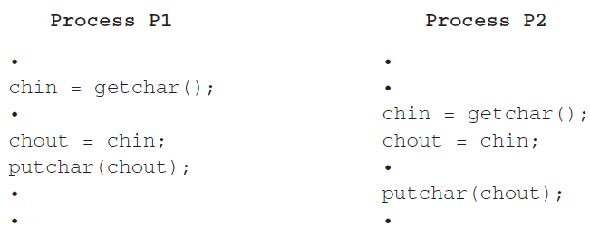
Sharing a reusable resource

Slide 19
Effects:
The result is that the character input to P1 is lost before being displayed, and the character input to P2 is displayed by both P1 and P2.
enforcing the mutual exclusive discipline would cause only one process at a time to run echo.

Slide 20
Mutual exclusion
If mutual exclusion law is enforced, this occur:
Processes P1 and P2 are both executing, each on a separate processor. P1 invokes the echo procedure.
While P1 is inside the echo procedure, P2 invokes echo. Because P1 is still inside the echo procedure (whether P1 is suspended or executing), P2 is blocked from entering the procedure. Therefore, P2 is suspended awaiting the availability of the echo procedure.
At a later time, process P1 completes execution of echo, exits that procedure, P2 is resumed and begins executing echo.

Slide 21
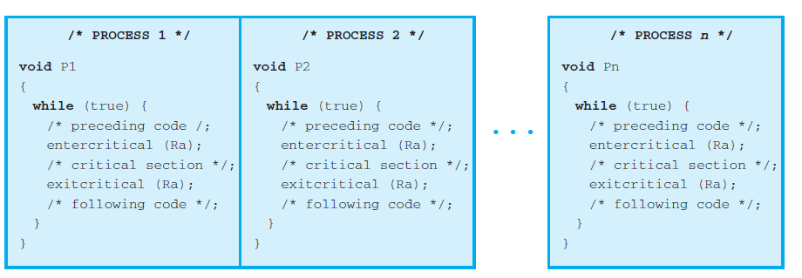
Mutual Exclusion

Slide 22
OS roles on Concurrent processes
The OS must be able to keep track of the various processes. This is done with
the use of process control blocks
The OS must allocate and de-allocate various resources for each active process.
At times, multiple processes want access to the same resource. These resources
Include:
• Processor time:
• Memory:
• Files
• I/O devices
The OS must protect the data and physical resources of each process against unintended
interference by other processes. This involves techniques that relate to
memory, files, and I/O devices.
The functioning of a process, and the output it produces, must be independent
of the speed at which its execution is carried out relative to the speed of other
concurrent processes

Slide 23
Requirements to Support Processor Cooperation / Mutualism
Any facility or capability that is to provide support for mutual exclusion should meet the following requirements:
Mutual exclusion must be enforced: Only one process at a time is allowed into its critical section, among all processes that have critical sections for the same resource or shared object.
A process that halts in its noncritical section must do so without interfering with other processes.
It must not be possible for a process requiring access to a critical section to be delayed indefinitely: ➔ no deadlock or starvation.
When no process is in a critical section, any process that requests entry to its critical section must be permitted to enter without delay.
No assumptions are made about relative process speeds or number of processors.
A process remains inside its critical section for a finite time only.

Slide 24
Platform for implementing Mutual Exclusion
Uniprocessor- multiprogramming, interleaving
Multiprocessor- many programs, many processors, overlapping, requires cooperation
Distributed systems- networked systems, require cooperation, queue management
Cloud computing, a kind of distributed platform
IOT environment

Slide 25
Concurrency: Mutual Exclusion and Synchronization methods

Slide 26
Definitions
critical section: a section of code which reads/writes shared data
race condition: potential for interleaved execution of a critical section by multiple threads => results are non-deterministic
mutual exclusion: synchronization mechanism to avoid race conditions by ensuring exclusive execution of critical sections
deadlock: permanent blocking of threads
starvation: execution but no progress

Slide 27
Conventional solutions for ME
Software reservation: a thread must register its intent to enter CS and then wait until no other thread has registered a similar intention before proceeding
Spin-locks using memory-interlocked instructions: requires special hardware to ensure that a given location can be read, modified and written without interruption (i.e. TST: test&set instruction)
Special variable-based mechanisms for ME: semaphores, monitors, message passing, lock files
they are equivalent !

Slide 28
Problems with concurrent execution
Concurrent processes (or threads) often need to share data (maintained either in shared memory or files) and resources ➔ contention
If there is no controlled access to shared data, some processes will obtain an inconsistent view of this data
The action performed by concurrent processes will then depend on the order in which their execution is interleaved when in critical section

Slide 29
An example
Process P1 and P2 are running this same procedure and have access to the same variable “a”
Processes can be interrupted anywhere
If P1 is first interrupted after user input and P2 executes entirely
Then the character echoed by P1 will be the one read by P2 !!
static char a;
void echo()
{
cin >> a;
cout << a;
}

Slide 30
Race Conditions
Situations like this where processes access the same data concurrently and the outcome of execution depends on the particular order in which the access takes place is called a race condition
How must the processes coordinate (or synchronise) in order to guard against race conditions?

Slide 31
The critical section problem
When a process executes code that manipulates shared data (or resource), we say that the process is in it’s critical section (CS) (for that shared data)
The execution of critical sections must be mutually exclusive: at any time, only one process is allowed to execute in its critical section (even with multiple CPUs)
Then each process must request the permission to enter it’s critical section (CS)

Slide 32
The critical section problem
The section of code implementing this request is called the entry section
The critical section (CS) might be followed by an exit section
The remaining code is the remainder section
The critical section problem is to design a protocol that the processes can use so that their action will not depend on the order in which their execution is interleaved (possibly on many processors)

Slide 33
Framework for analysis of solutions
Each process executes at nonzero speed but no assumption on the relative speed of n processes
General structure of a process:
many CPU may be present but memory hardware prevents simultaneous access to the same memory location
No assumption about order of interleaved execution
For solutions: we need to specify entry and exit sections
repeat
entry section
critical section
exit section
remainder section
forever

Slide 34
Requirements for a valid solution to the critical section problem
Mutual Exclusion
At any time, at most one process can be in its critical section (CS)
Progress
Only processes that are not executing in their RS (REMAINDER SECTION) can participate in the decision of who will enter next in the CS.
This selection cannot be postponed indefinitely
Hence, we must have no deadlock

Slide 35
Requirements for a valid solution to the critical section problem (cont.)
Bounded Waiting
After a process has made a request to enter it’s CS, there is a bound on the number of times that the other processes are allowed to enter their CS
otherwise the process will suffer from starvation

Slide 36
What about process failures?
If all 3 criteria (ME, progress, bounded waiting) are satisfied, then a valid solution will provide robustness against failure of a process in its remainder section (RS)
since failure in RS is just like having an infinitely long RS
However, no valid solution can provide robustness against a process failing in its critical section (CS)
A process Pi that fails in its CS does not signal that fact to other processes: for them Pi is still in its CS

Slide 37
Types of solutions
Software solutions
algorithms who’s correctness does not rely on any other assumptions (see framework)
Hardware solutions
rely on some special machine instructions
Operating System solutions
provide some functions and data structures to handle race condition

Slide 38
OS Solutions: Semaphores
Synchronization tool (provided by the OS) that do not require busy waiting
A semaphore S is an integer variable that, apart from initialization, can only be accessed through 2 atomic and mutually exclusive operations:
wait(S)
signal(S)
To avoid busy waiting: when a process has to wait, it will be put in a blocked queue of processes waiting for the same event

Slide 39
Semaphores
A semaphore is a record (structure):
type semaphore = record
count: integer;
queue: list of processes
end;
var S: semaphore;
When a process must wait for a semaphore S, it is blocked and put on the semaphore’s queue
The signal operation removes (acc. to a fair policy like FIFO) one process from the queue and puts it in the list of ready processes

Slide 40
Semaphore’s operations
wait(S):
S.count--;
if (S.count<0) {
block this process
place this process in S.queue
}
signal(S):
S.count++;
if (S.count<=0) {
remove a process P from S.queue
place this process P on ready list
}
S.count must be initialized to a nonnegative value (depending on application)

Slide 41
Semaphores: observations
When S.count >=0: the number of processes that can execute wait(S) without being blocked = S.count
When S.count<0: the number of processes waiting on S is = |S.count|
Atomicity and mutual exclusion: no 2 processes can be in wait(S) and signal(S) (on the same S) at the same time (even with multiple CPUs)
Hence the blocks of code defining wait(S) and signal(S) are, in fact, critical sections

Slide 42
Using semaphores for solving critical section problems
For n processes
Initialize S.count to 1
Then only 1 process is allowed into CS (mutual exclusion)
To allow k processes into CS, we initialize S.count to k
Process Pi:
repeat
wait(S);
CS
signal(S);
RS
forever

Slide 43
Using semaphores to synchronize processes
Proper synchronization is achieved by having in P1:
S1;
signal(synch);
And having in P2:
wait(synch);
S2;
We have 2 processes: P1 and P2
Statement S1 in P1 needs to be performed before statement S2 in P2
Then define a semaphore “synch”
Initialize synch to 0

Slide 44
The producer/consumer problem
A producer process produces information that is consumed by a consumer process
Ex1: a print program produces characters that are consumed by a printer
Ex2: an assembler produces object modules that are consumed by a loader
We need a buffer to hold items that are produced and eventually consumed
A common paradigm for cooperating processes

Slide 45
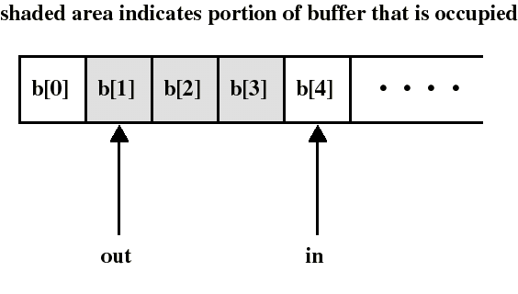
P/C: unbounded buffer
We assume first an unbounded buffer consisting of a linear array of elements
in points to the next item to be produced
out points to the next item to be consumed

Slide 46
P/C: unbounded buffer
We need a semaphore S to perform mutual exclusion on the buffer: only 1 process at a time can access the buffer
We need another semaphore N to synchronize producer and consumer on the number N (= in - out) of items in the buffer
an item can be consumed only after it has been created

Slide 47
P/C: unbounded buffer
The producer is free to add an item into the buffer at any time: it performs wait(S) before appending and signal(S) afterwards to prevent customer access
It also performs signal(N) after each append to increment N
The consumer must first do wait(N) to see if there is an item to consume and use wait(S)/signal(S) to access the buffer

Slide 48
Solution of P/C: unbounded buffer
Initialization:
S.count:=1;
N.count:=0;
in:=out:=0;
append(v):
b[in]:=v;
in++;
Producer:
repeat
produce v;
wait(S);
append(v);
signal(S);
signal(N);
forever
Consumer:
repeat
wait(N);
wait(S);
w:=take();
signal(S);
consume(w);
forever
take():
w:=b[out];
out++;
return w;
critical sections

Slide 49
P/C: unbounded buffer
Remarks:
Putting signal(N) inside the CS of the producer (instead of outside) has no effect since the consumer must always wait for both semaphores before proceeding
The consumer must perform wait(N) before wait(S), otherwise deadlock occurs if consumer enter CS while the buffer is empty
Using semaphores is a difficult art...

Slide 50

The Dining Philosophers Problem
5 philosophers who only eat and think
each need to use 2 forks for eating
we have only 5 forks
A classical synchron. problem
Illustrates the difficulty of allocating resources among process without deadlock and starvation

Slide 51
The Dining Philosophers Problem
Each philosopher is a process
One semaphore per fork:
fork: array[0..4] of semaphores
Initialization: fork[i].count:=1 for i:=0..4
A first attempt:
Deadlock if each philosopher start by picking his left fork!
Process Pi:
repeat
think;
wait(fork[i]);
wait(fork[i+1 mod 5]);
eat;
signal(fork[i+1 mod 5]);
signal(fork[i]);
forever

Slide 52
The Dining Philosophers Problem
A solution: admit only 4 philosophers at a time that tries to eat
Then 1 philosopher can always eat when the other 3 are holding 1 fork
Hence, we can use another semaphore T that would limit at 4 the number of philosophers “sitting at the table”
Initialize: T.count:=4
Process Pi:
repeat
think;
wait(T);
wait(fork[i]);
wait(fork[i+1 mod 5]);
eat;
signal(fork[i+1 mod 5]);
signal(fork[i]);
signal(T);
forever

Slide 53
Binary semaphores
The semaphores we have studied are called counting (or integer) semaphores
We have also binary semaphores
similar to counting semaphores except that “count” is Boolean valued
counting semaphores can be implemented by binary semaphores...
generally more difficult to use than counting semaphores (eg: they cannot be initialized to an integer k > 1)

Slide 54
Binary semaphores
waitB(S):
if (S.value = 1) {
S.value := 0;
} else {
block this process
place this process in S.queue
}
signalB(S):
if (S.queue is empty) {
S.value := 1;
} else {
remove a process P from S.queue
place this process P on ready list
}

Slide 55
Problems with semaphores
semaphores provide a powerful tool for enforcing mutual exclusion and coordinate processes
But wait(S) and signal(S) are scattered among several processes. Hence, difficult to understand their effects
Usage must be correct in all the processes
One bad (or malicious) process can fail the entire collection of processes

Slide 56
Monitors
Are high-level language constructs that provide equivalent functionality to that of semaphores but are easier to control
Found in many concurrent programming languages
Concurrent Pascal, Modula-3, uC++, Java...
Can be implemented by semaphores...

Slide 57
Monitor
Is a software module containing:
one or more procedures
an initialization sequence
local data variables
Characteristics:
local variables accessible only by monitor’s procedures
a process enters the monitor by invoking one of it’s procedures
only one process can be in the monitor at any one time

Slide 58
Monitor
The monitor ensures mutual exclusion: no need to program this constraint explicitly
Hence, shared data are protected by placing them in the monitor
The monitor locks the shared data on process entry
Process synchronization is done by the programmer by using condition variables that represent conditions a process may need to wait for before executing in the monitor

Slide 59
Condition variables
are local to the monitor (accessible only within the monitor)
can be access and changed only by two functions:
cwait(a): blocks execution of the calling process on condition (variable) a
the process can resume execution only if another process executes csignal(a)
csignal(a): resume execution of some process blocked on condition (variable) a.
If several such process exists: choose any one
If no such process exists: do nothing

Slide 60
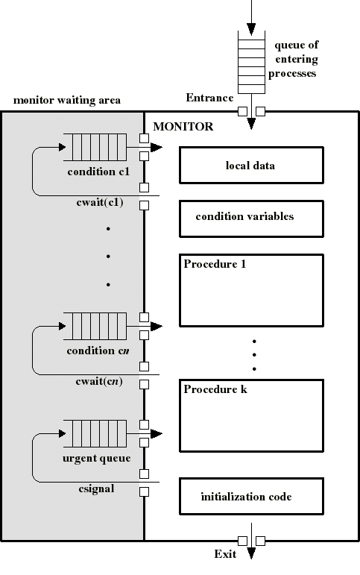
Monitor
Awaiting processes are either in the entrance queue or in a condition queue
A process puts itself into condition queue cn by issuing cwait(cn)
csignal(cn) brings into the monitor 1 process in condition cn queue
Hence csignal(cn) blocks the calling process and puts it in the urgent queue (unless csignal is the last operation of the monitor procedure)

Slide 61
Producer/Consumer problem
Two types of processes:
producers
consumers
Synchronization is now confined within the monitor
append(.) and take(.) are procedures within the monitor: are the only means by which P/C can access the buffer
If these procedures are correct, synchronization will be correct for all participating processes
ProducerI:
repeat
produce v;
Append(v);
forever
ConsumerI:
repeat
Take(v);
consume v;
forever

Slide 62
Message Passing
Is a general method used for interprocess communication (IPC)
for processes inside the same computer
for processes in a distributed system
Yet another mean to provide process synchronization and mutual exclusion
We have at least two primitives:
send(destination, message)
received(source, message)
In both cases, the process may or may not be blocked

Slide 63
Synchronization in message passing
For the sender: it is more natural not to be blocked after issuing send(.,.)
can send several messages to multiple dest.
but sender usually expect acknowledgment of message receipt (in case receiver fails)
For the receiver: it is more natural to be blocked after issuing receive(.,.)
the receiver usually needs the info before proceeding
but could be blocked indefinitely if sender process fails before send(.,.)

Slide 64
Synchronization in message passing
Hence other possibilities are sometimes offered
Ex: blocking send, blocking receive:
both are blocked until the message is received
occurs when the communication link is unbuffered (no message queue)
provides tight synchronization (rendez-vous)

Slide 65
Addressing in message passing
direct addressing:
when a specific process identifier is used for source/destination
but it might be impossible to specify the source ahead of time (ex: a print server)
indirect addressing (more convenient):
messages are sent to a shared mailbox which consists of a queue of messages
senders place messages in the mailbox, receivers pick them up

Slide 66
Enforcing mutual exclusion with message passing
create a mailbox mutex shared by n processes
send() is non blocking
receive() blocks when mutex is empty
Initialization: send(mutex, “go”);
The first Pi who executes receive() will enter CS. Others will be blocked until Pi resends msg.
Process Pi:
var msg: message;
repeat
receive(mutex,msg);
CS
send(mutex,msg);
RS
forever

Slide 67
The bounded-buffer P/C problem with message passing
We will now make use of messages
The producer place items (inside messages) in the mailbox mayconsume
mayconsume acts as our buffer: consumer can consume item when at least one message is present
Mailbox mayproduce is filled initially with k null messages (k= buffer size)
The size of mayproduce shrinks with each production and grows with each consumption
can support multiple producers/consumers

Slide 68
The bounded-buffer P/C problem with message passing
Producer:
var pmsg: message;
repeat
receive(mayproduce, pmsg);
pmsg:= produce();
send(mayconsume, pmsg);
forever
Consumer:
var cmsg: message;
repeat
receive(mayconsume, cmsg);
consume(cmsg);
send(mayproduce, null);
forever

